Slide 1
Master in Data Science
October 2023
Capstone Project by:
Wafa khadher (T.Leader)
Oscar Hernandez
Jeswin Sebi Puthussery
Maroua Marouani
Project Title
Oracle "ORA-FASHION Ltd Customer segmentation and marketing mission“
Rome, September 2024
Notes:
2 slides, Introduction to the Project

Slide 2

ORA-FASHION Ltd
€1.578 mln Revenue
&
€0.868 mln Profits
MISSION: develop marketing strategies targeted at specific customer segments and provide them with customized offers, leveraging available information about their buying habits
VISION: cultivate and strengthen relationships with customers critical to company business
Success Reason: High-quality garments, supported by a fully traceable and transparent Made in Italy supply chain.
Strategic positioning, which enhances the perceived value of its products compared to competitors.
Notes:
2 slides, Introduction to the Project
Company Introduction
ORA-FASHION Ltd is a retail company, newly established in the fashion industry in Europe

Slide 3

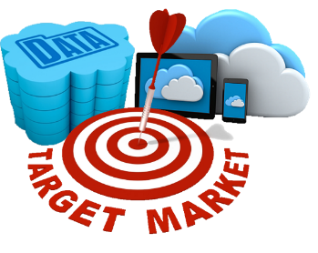
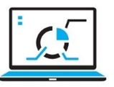

ORA-FASHION Ltd Business challenge
Marketing strategy Support: Assist ORA-FASHION in designing and implementing personalized marketing campaigns to reach segmented audiences.
Customer Value Estimation: Utilize advanced data analysis tools to estimate the current value of the customer base.
Data-Driven Analysis: Use advanced data tools to segment customers based on buying habits, including recency, frequency, and monetary value of purchases.
Customer Segmentation: Identify key customer clusters and analyze their characteristics in depth.
Notes:
1/6
6 slides, Main body (Identification of the business challenge, strategies, solutions and methodology used)
Business challenge : given its recent arrival on the market and overcoming barriers of entry into the industry, ORA-FASHION wants to get to know its customer base in greater depth in order to plan targeted marketing campaigns and develop customized offers for its customers And offer a more innovative and customer-centered service, in order to expand and consolidate its market share

Slide 4


Implemented Strategies
Customer segmentation using K means
EDA analysis and Visualization through a interactive dashboard
CLV calculation
Marketing strategy
Notes:
2/6
- 6 slides, Main body (Identification of the business challenge, strategies, solutions and methodology used)

Slide 5
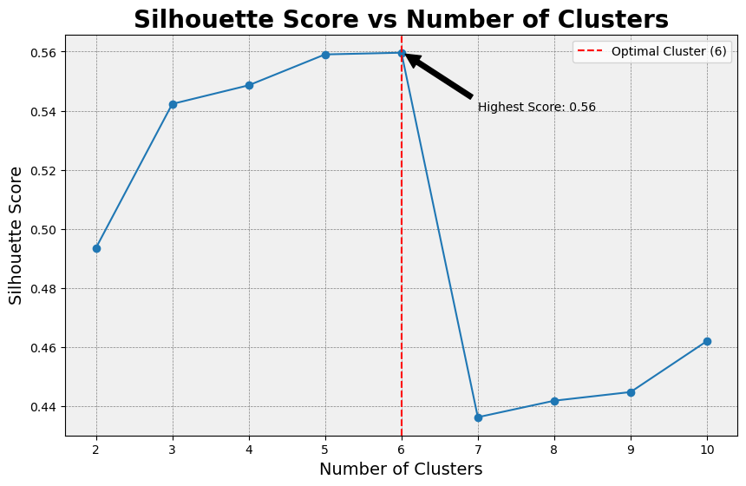
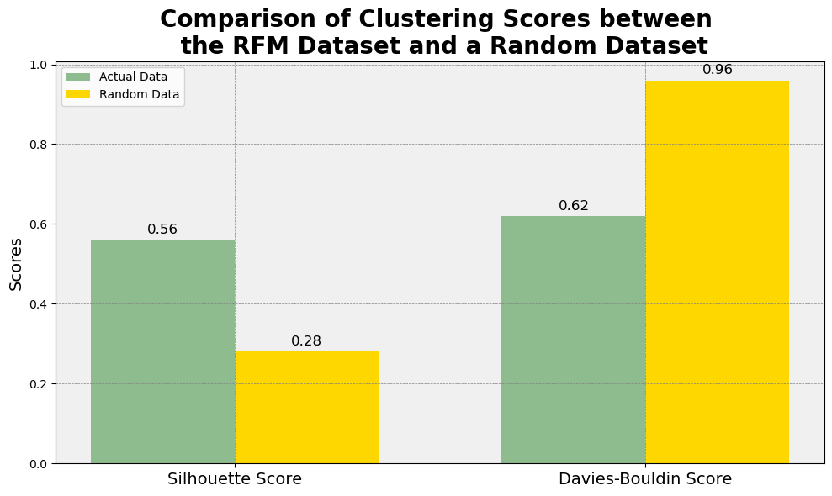
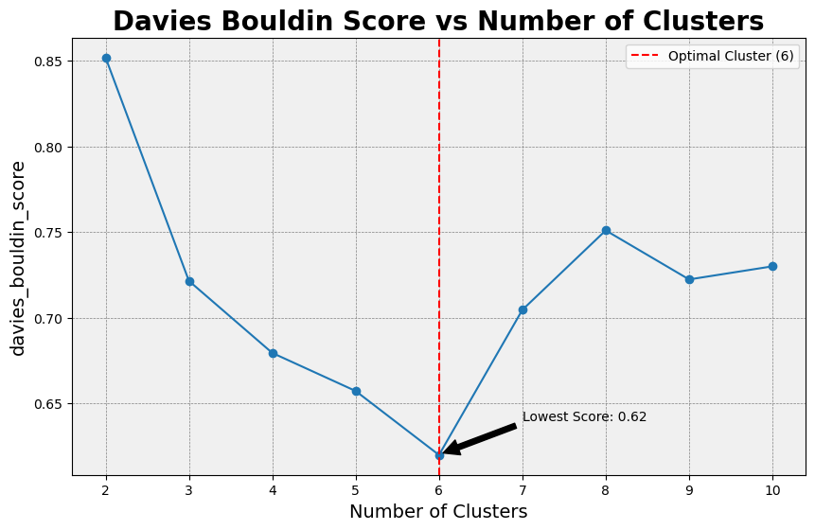
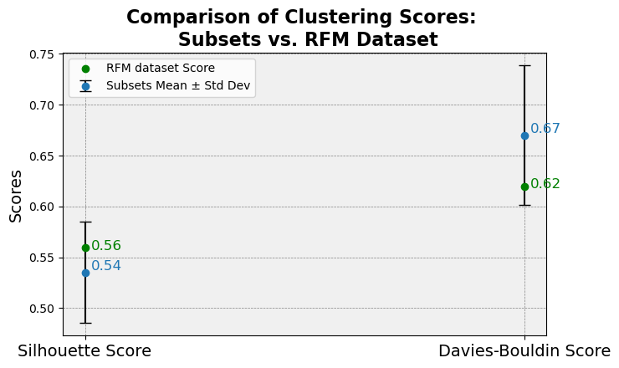
Methodology – Customer segmentation
A) Cluster validation higher -> better
C) Structure validation
Steps
1. Calculate RFM variables:
Recency
Frequency
Monetary Value
2. Data Preprocessing:
Standardization
3. Formation of clusters:
unsupervised clustering algorithm (Kmeans)
4. Cluster Validation:
Silhouette score
Davies Bouldin score
5. Other validations:
Structure validation
Stability validation
B) Cluster validation lower -> better
D) Stability validation
Notes:
5/6
- 6 slides, Main body (Identification of the business challenge, strategies, solutions and methodology used)

Slide 6
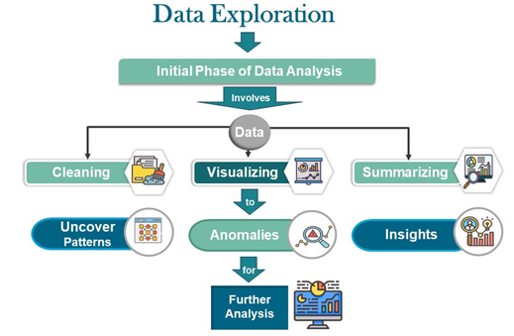
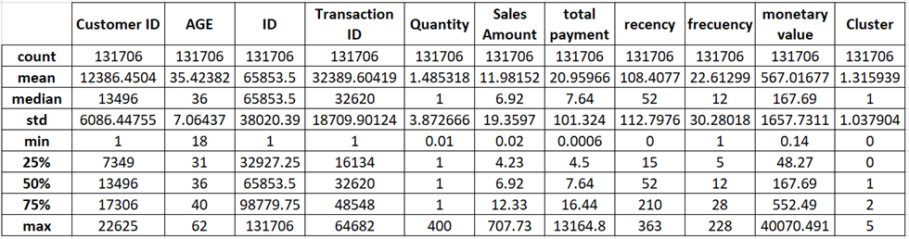
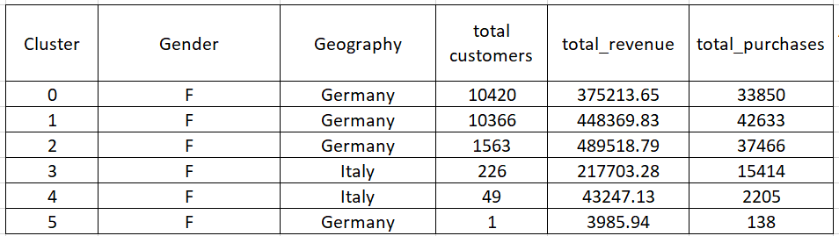
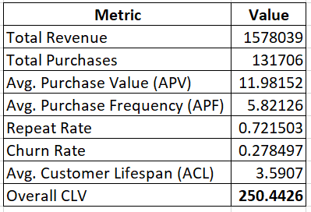
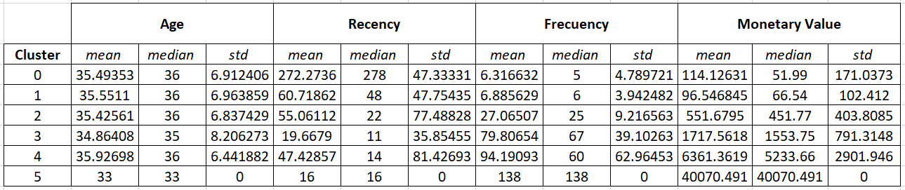
Exploratory data analysis EDA and Customer live Value Calculation
CLV Calculation
Notes:
6/6
6 slides, Main body (Identification of the business challen
Data Cleaning & Preparation:
Descriptive Statistics:
Summary of key metrics (e.g., average sales amount $11.98, average customer age 35 years).
Statistical Summary using average, median, maximum, minimum , std
Frequency counts for categorical columns
Visualization Insights:
Gender Distribution: Majority are female customers (12,636 out of 22,625).
Geography Distribution: Majority of customers from Germany, Italy, and France.
Sales Trends: Highest sales in December due to holiday season.
ge, strategies, solutions and methodology used)
Clustering information visualization.
Identify any interesting patterns.

Slide 7
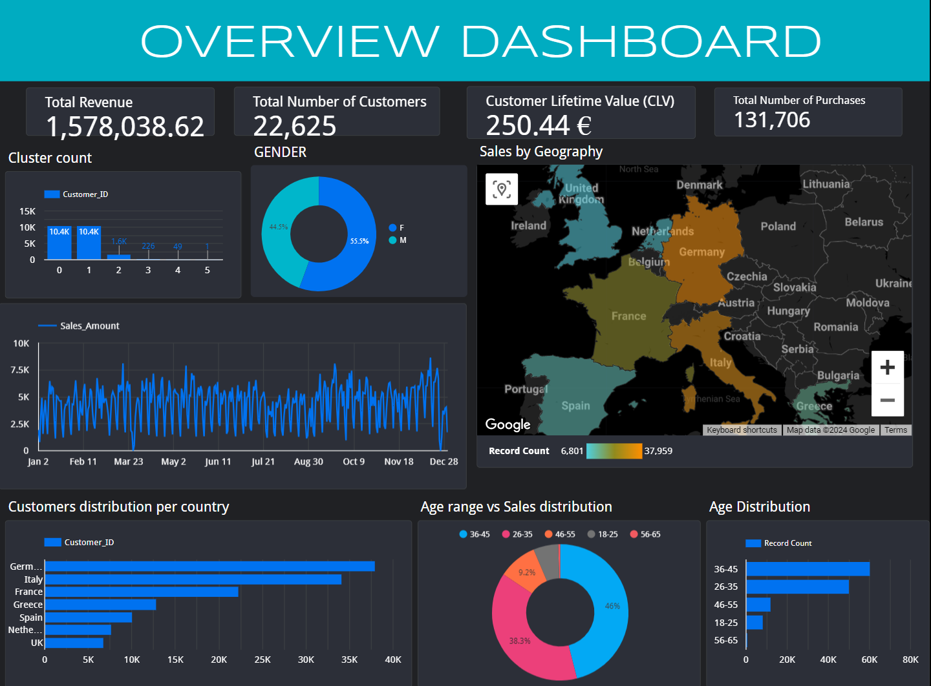
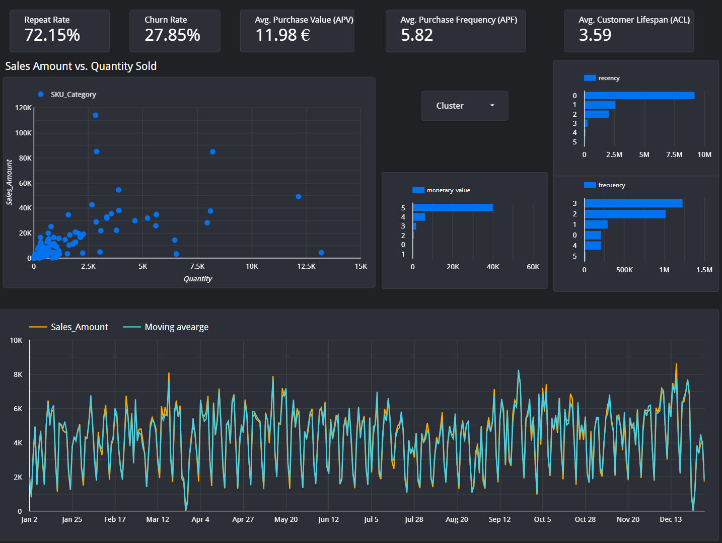
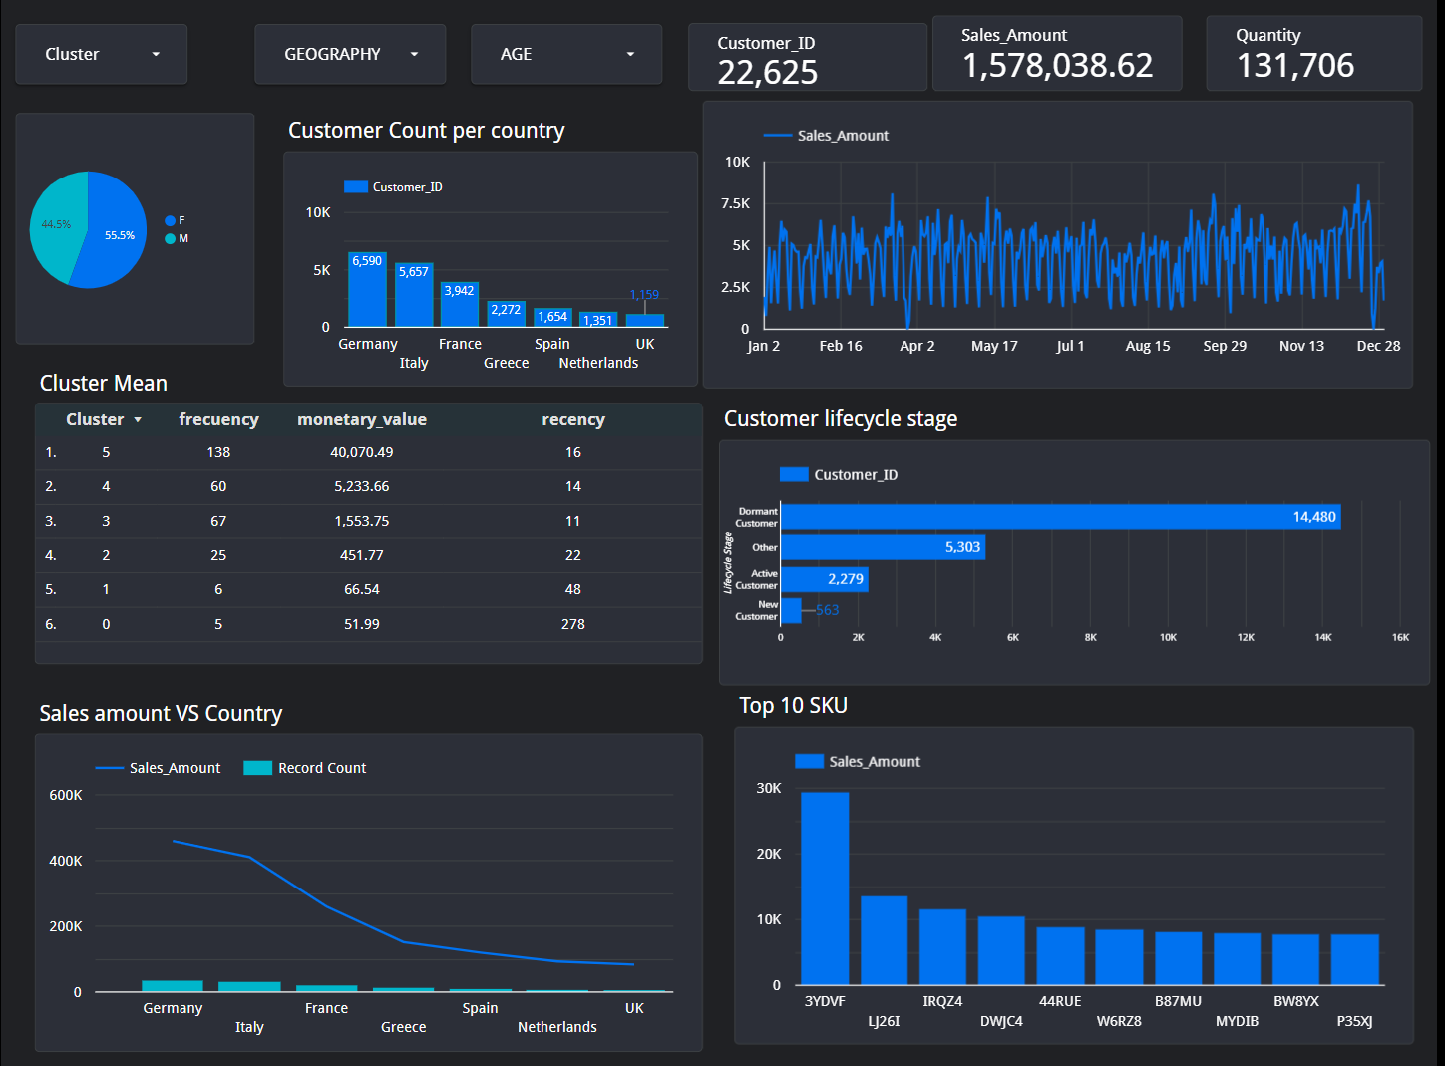
Solutions
1. Overview Dashboard:
Quick performance snapshot with KPIs.
Maps and donut charts for geographical and categorical insights.
2. EDA Insight Dashboard:
Uncovers patterns with KPIs and scatter plots.
Bar charts and time series for trend analysis.
3. Cluster Analysis Dashboard:
Compares clusters with bar, donut, and combo charts.
Time series for tracking cluster trends.
Notes:
4/6
- 6 slides, Main body (Identification of the business challenge, strategies, solutions and methodology used)

Slide 8
Marketing strategy
1. Geographical Segmentation Insights:
High Sales Regions: Germany, Italy
Medium Sales Regions: France, Greece
Low Sales Regions: Spain, Netherlands, UK
2. Customer Clusters Insights:
Cluster 5 (High-Value Customers): ~$40K in sales
Cluster 4 (Medium-High Value Customers): ~$5K in sales
Cluster 3 (Medium-Value Customers): ~$1.5K in sales
Clusters 0, 1 & 2 (Low-Value Customers): ~$500 combined in sales
3. Key Strategies:
Cluster 5: Loyalty Programs, Personalized Communication, Premium Services
Cluster 4: Regular Engagement, Upselling/Cross-Selling, Feedback Requests
Cluster 3: Targeted Promotions, Educational Content, Customer Surveys
Clusters 0, 1, 2: Re-engagement Campaigns, Basic Communication, Awareness Campaigns
4. Implementation Plan:
Data Integration: Centralize customer and sales data for effective segmentation.
Marketing Automation: Use tools like Mailchimp or HubSpot for personalized campaigns.
Regular Monitoring: Track and adjust strategies based on campaign performance.
Customer Feedback Loop: Continuously gather insights to refine segmentation
Notes:
4/6
- 6 slides, Main body (Identification of the business challenge, strategies, solutions and methodology used)

Slide 9
Conclusion
The Exploratory Data Analysis (EDA) section, key data patterns were identified, including demographic insights, purchasing behavior trends, and significant variables that informed further analysis. The CLV calculation and cluster insights provided a detailed understanding of customer value distribution, highlighting segments with high engagement and spending, which are crucial for developing targeted marketing strategies aimed at optimizing customer retention and business growth.
The project successfully delivered key insights into ORA-FASHION Ltd.'s customer behavior through comprehensive data analysis and the creation of an interactive dashboard. These insights, coupled with the user-friendly visualizations, empower the company to make informed strategic decisions, ultimately enhancing customer engagement and driving sustained business growth.
The data-driven marketing strategy for ORA-FASHION Ltd. targets customer segments with tailored approaches to maximize engagement and sales. By focusing on key regions like Germany, Italy, and France, and addressing the unique needs of each customer cluster, ORA-FASHION is positioned to boost loyalty, increase spending, and foster long-term growth.
The customer segmentation process, utilizing RFM analysis and K-means clustering, proved to be a robust method for categorizing ORA-FASHION Ltd.'s customers into six distinct segments. By optimizing the number of clusters using silhouette and Davies-Bouldin scores and validating the model through a split-dataset approach, the segmentation achieved a high level of stability and reliability
Notes:
1 slide, Final overall conclusion

Slide 10
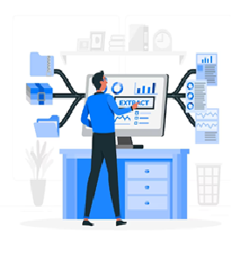
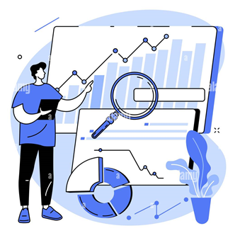
Recommendations
Expand Data Sources in one reporting system:
Net Promoter Score (NPS) or Customer Satisfaction Score (CSAT)
Customer feedback and comments
Browsing behavior analysis
Product reviews and categorization in data sources
Data-Driven Personalization Actions
A/B Testing for Marketing Strategies
Use Customer Data for Personalization
Focus on Best-Selling Products
Seasonal and Event-Based Promotions
Notes:
1 slide, Future Recommendations for the company/business
Expand Data Sources
Incorporate Additional Data Sources:
Net Promoter Score (NPS) or Customer Satisfaction Score (CSAT)
Customer feedback and comments
Browsing behavior analysis
Product categorization in data sources
Benefit: Gain a comprehensive understanding of customer preferences to refine product bundling, suggestions, and pricing strategies.
Data-Driven Personalizated Actions
A/B Testing for Marketing Strategies:
Conduct A/B tests to understand how different user segments respond to changes.
Use the data to make informed business decisions and enable immediate marketing interventions.
Use Customer Data for Personalization:
Dynamically tailor marketing content using customer data.
Example: Use mail merge to personalize emails, recommendations, and promotions based on past purchases, browsing history, and demographics.
Focus on Best-Selling Products:
Prioritize marketing efforts on top-selling products, especially those appealing to key customer segments (e.g., women aged 25-40).
Focus: This demographic is critical for ORA-FASHION.
Seasonal and Event-Based Promotions:
Align marketing campaigns with monthly sales trends, seasonal patterns, and event-based shopping behaviors.
Example: Intensify efforts around back-to-school promotions, Black Friday, and the holiday season to maximize sales during peak periods.

